Slide 1
Lecture 3 Pre-processing serological data
May 21, 2025
Seroanalytics Training Blantyre, Malawi

Slide 2
Lecture outline
What is pre-processing and why is it important?
Can we measure whether pre-processing is effective?
Pipeline for pre-processing data
Filter for quality (bead count)
Background correction
Transformation
Standardization
Normalization

Slide 3
What is preprocessing?
Pre-processing is a serries of steps taken to transform data before formal analysis and inference (e.g., hypothesis testing) is undertaken.
Usually, the goals of pre-processing are to get the data “in shape” to apply a particular statistical or mathematical test or model.
Getting data in shape can include several goals:
checking distributional assumptions for parametric tests
log transformation for visualization
reducing technical variation

Slide 4
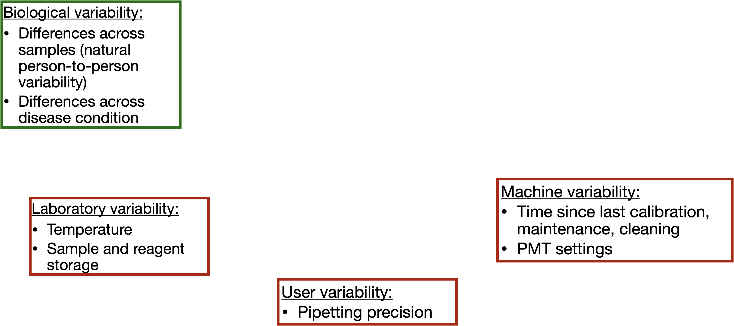
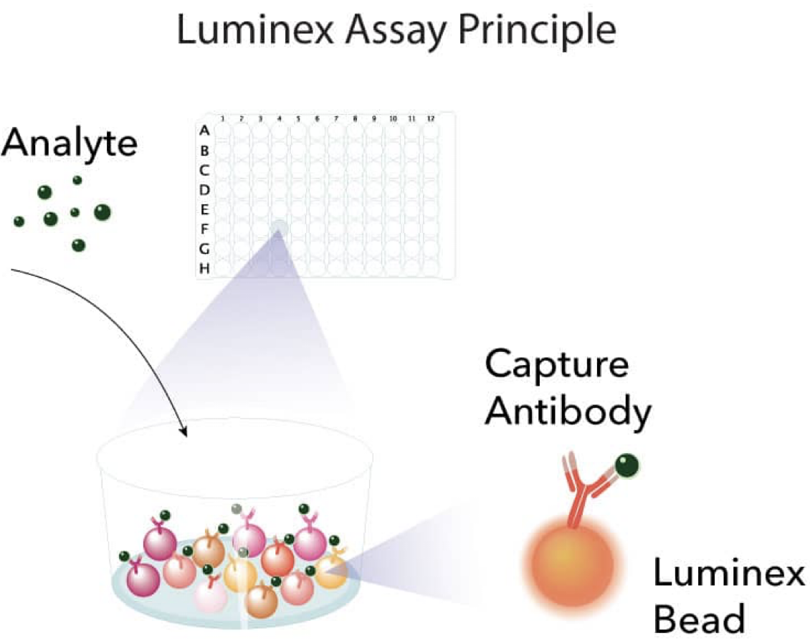
Raw MFIs contain biological and technical variation

Slide 5
Why is pre-processing important?
What might happen if we don’t perform any pre-processing whatsoever?
We may apply a parametric statistical test (a statistical test that makes distributional assumptions about data) that is inappropriate.
If we leave a substantial amount of technical variation in our data, we may attribute observed differences to biological mechanisms when they are in fact the result of technical differences.

Slide 6
How can we assess whether pre-processing is effective?
We will focus on the goal of removing technical variation.
We will use technical replicates to accomplish this goal, that is, samples that we re-measure at various points during the assay.
The assumption we rely on is that any differences we measure across these samples cannot be biological in nature, and therefore must be the result of technical variation.

Slide 7
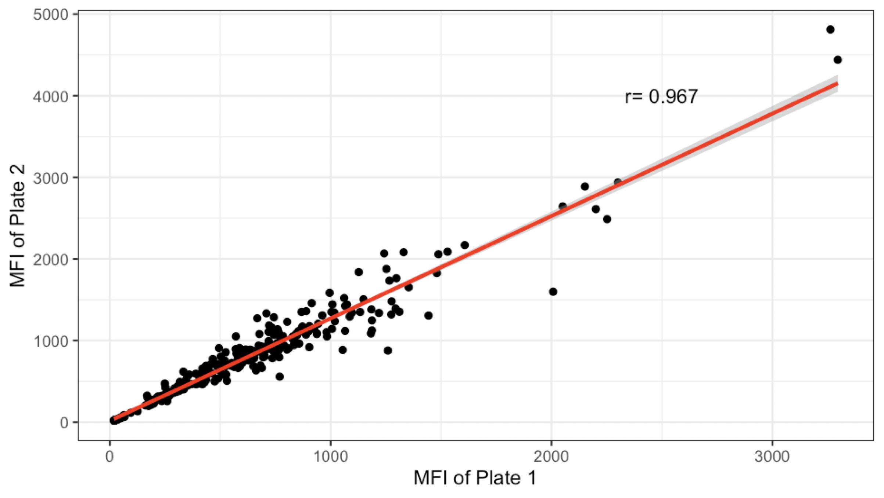
Running same samples on two plates
What happens if we just measure correlation?
What would you conclude about technical differences between these two plates?

Slide 8
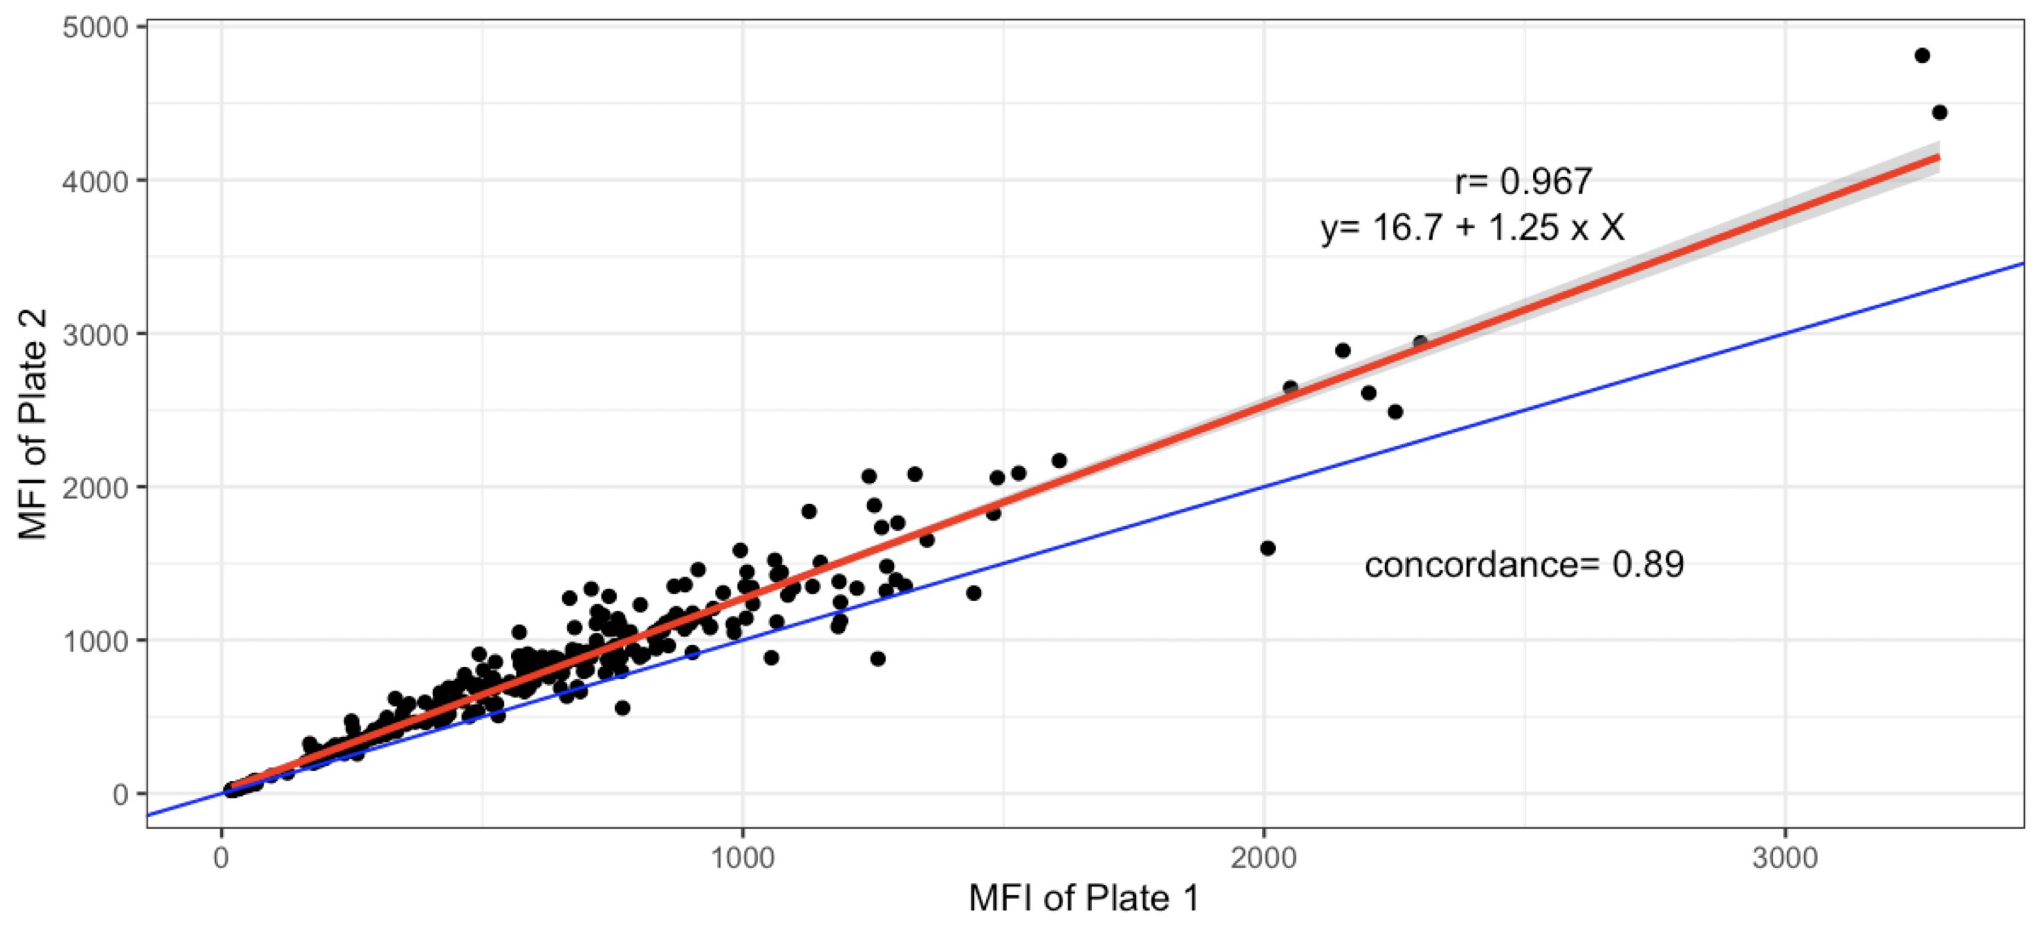
Running same samples on two plates
Now, what happens if we measure correlation specifically around the line y=x?
What might we conclude about these two plates?

Slide 9
Evaluating whether pre-processing was effective
By measuring concordance across technical replicates throughout an assay (e.g., between plates, batches, or other assay units), we can assess the level of technical variation.
The goal of removing technical variation is often not accomplished with one single transformation or step; multiple steps may be necessary.
The ordering of these steps is also important.
A particular series and ordering of steps that pre-process data is referred to as a pre-processing pipeline.

Slide 10



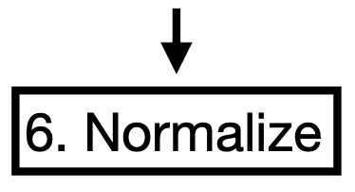
An example pipeline for pre-processing data
5. Fit standard curves and estimate log concentrations

Slide 11

An example pipeline for pre-processing data
This step can also ensure data are in ‘tidy’ format.

Slide 12
An example pipeline for pre-processing data

Slide 13
Bead counts
In bead-based assays, antigens of interest are bound to beads that have a specific identification.
Since these are multiplexed assays, we may be interested in measuring antibody responses to more than one type of antigen.
Each type of antigen is bound to a set of beads with a unique identifier.
This way, the number of beads read for each antigen can be computed, and the fluorescence for each antigen is taken as the median of the measured fluorescence for all beads with the identifier corresponding to that specific antigen.

Slide 14
Bead counts
When a very small number of beads for a particular antigen (one bead ID) are read by the machine, this is usually an issue.
It can be the result of technical difficulties with the assay or the fluidics of the reading or scanning machine.
In these cases, the median fluorescence measurement for this particular antigen can be unreliable.
Therefore, it is common to set a threshold for a minimum number of beads required to proceed with analysis for a particular antigen in a specific sample (e.g., 30 or 50 beads are common thresholds).

Slide 15
An example pipeline for pre-processing data

Slide 16
What is background?
Background is signal that is not the result of a specific binding event between an antigen and an antibody.
It is often the result of autofluorescence, that is fluorescence resulting from the reagents used for the assay.
Therefore, background is typically measured with ‘blank’ wells, that is wells that contain all reagents for the assay but no sample.
These are usually placed at least once on every plate, but can be present more than once.

Slide 17
Background correction
Techniques to remove background include:
Subtraction: MFI of sample – MFI blank
Division: MFI of sample / MFI blank
This is typically done on a plate-by-plate basis; therefore, if there is more than one blank well per plate, “MFI blank” could be the median or mean of all blank wells on that plate.
An important factor to consider is that if the MFI of a sample is lower or equal to the MFI of blank well(s), the subtraction may produce a value less than or equal to 0.

Slide 18
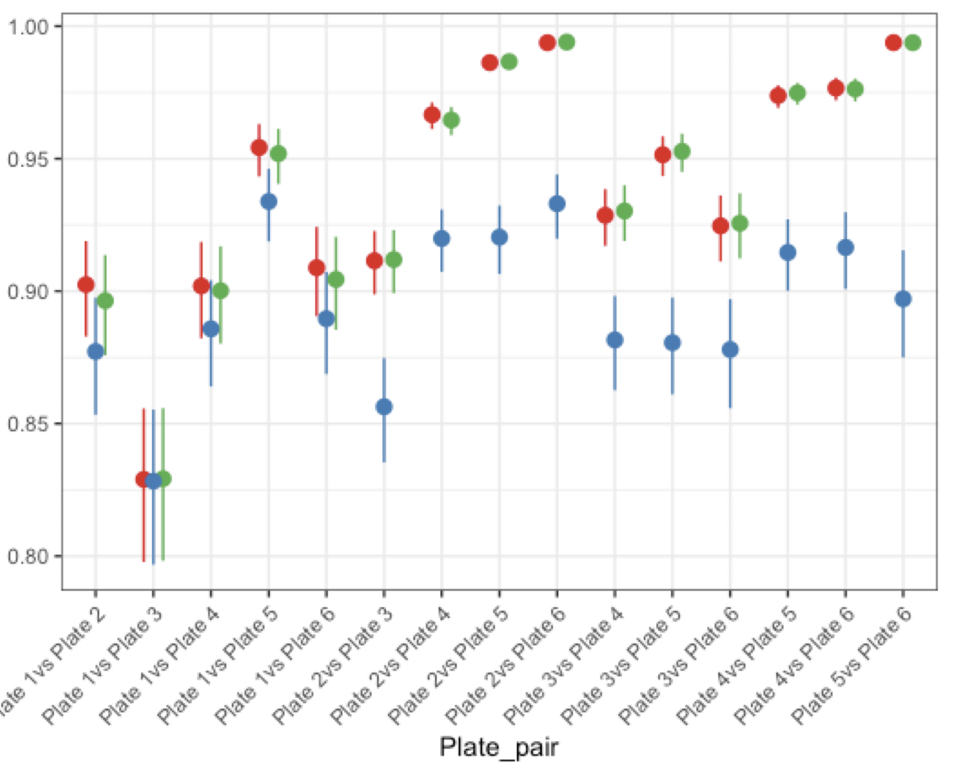
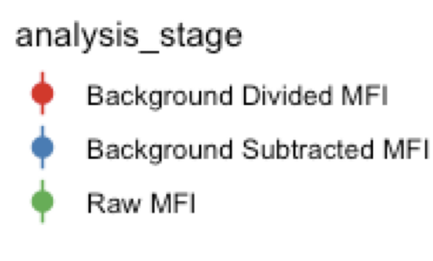
Example results of background correction
MBA for malaria study (6 x 384 well plates, 19 P. falciparum antigens)

Slide 19
An example pipeline for pre-processing data
5. Fit standard curves and estimate log concentrations

Slide 20
Standardization
Standardization changes MFI measurements to other units of concentration that can be useful for certain antigens.
Examples of concentration units include:
Relative Antibody Units (RAU)
International Units (IU): can correspond to WHO guidelines for protective immunity (see Part 4 for VPD example)
This process is accomplished by having serial dilutions of a sample with known concentrations (measured as a dilution factor, RAU, IU, etc). This serial dilution is then run on one or more plates and a relationship between concentration and MFI is established.

Slide 21
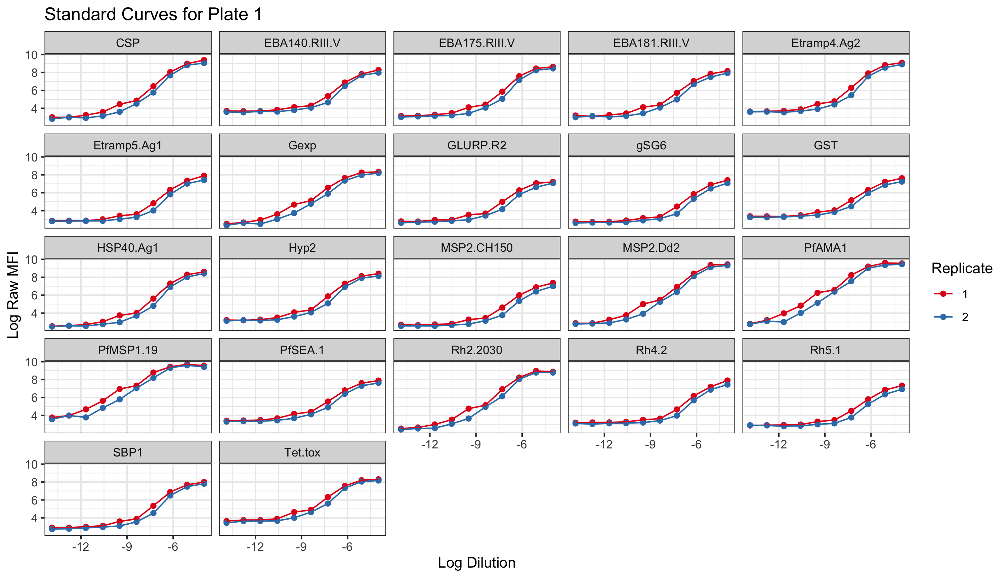
Example of a standard curve:
This “S” shaped curve is the ideal shape between log MFI and log concentration (in this case, measured as a dilution factor).
It is called a logistic curve and typically only exists when you observe both MFI and concentration on the log scales.

Slide 22
Example of a standard curve:
We can estimate the equation that describes each logistic curve.
Then, using that equation, we can transform a specific sample’s MFI into an estimate of concentration (e.g., RAU or IU).
This can be done on a plate-by-plate basis if standard curves are available on all plates.
Or, it can be done once for an entire study if there is only one standard curve available.

Slide 23
An example pipeline for pre-processing data
5. Fit standard curves and estimate log concentrations

Slide 24
Normalization
Oftentimes, when we run an experiment in the lab it is not possible to run all the samples from a study all at once.
They are often broken down into smaller units (e.g., plates) and then even these units can be run at different times (e.g., in different batches).
Normalization seeks to remove differences between units or batches.
We will work with a simple method (there are many!)
We will use technical replicates that are measured repeatedly in each batch to normalize.

Slide 25
Normalization method
We will work on the assumption that differences across these technical replicates are strictly due to technical variation.
Therefore, we want to remove these differences.
We will estimate the mean difference due to technical variation between each plate by fitting a linear model to the technical replicate data which is on the log concentration scale (recall, we just fit our standard curve!).
Then we will subtract this estimated mean difference from all log concentrations, that is cohort samples.
These normalized values will then be used for downstream analysis.

Slide 26
An example pipeline for pre-processing data
5. Fit standard curves and estimate log concentrations

Slide 27
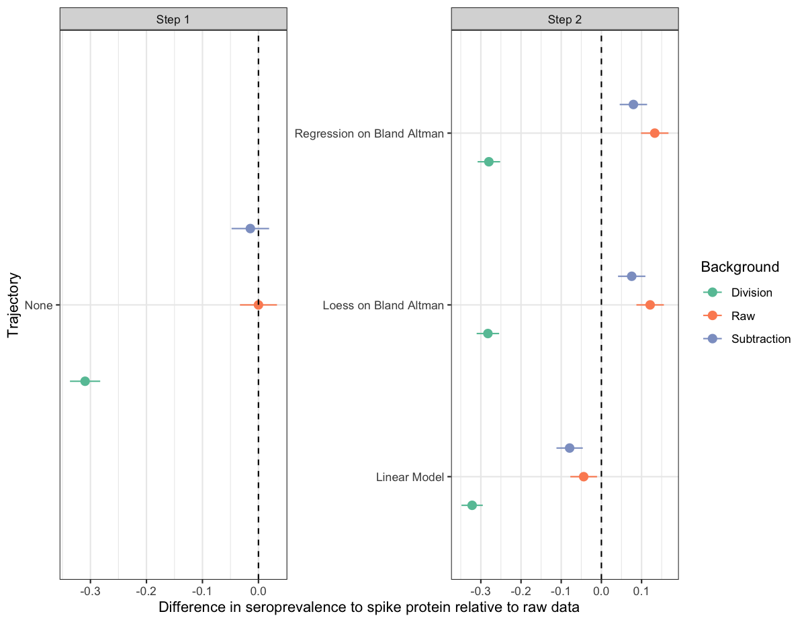
A quick example of the impact of pre-processing.

Slide 28
Conclusion
Pre-processing can directly remove some technical variation and ensure our data are “in shape” to perform our analysis and get accurate inference.
The ”best” combination of pre-processing steps can be evaluated by measuring concordance across technical replicates and may vary across data.
This means that technical replicates are important when you are considering assay design!
Pre-processing makes a difference in downstream inference.

